Slide 1
Newgen
© 2013 NS. All rights reserved.

Slide 2
About
Newgen is a Desktop Customizing application made over .NET Framework 4 for Window 7. It’s a Metro inspired application with seamless integration of Widgets, Internet, and some useful features. It’s also extensible, means that you can create Widgets, that get into Tiles Screen, if you know C# or VB.NET programing in WPF platform or HTML5 with JavaScript basics.

Slide 3
Integrated Usage Guide
Overview
What's new ?
StartScreen
StartScreen Groups
Shortcuts
StartBar
UserTile, ThumbsBar, TilesBar
Tiles and App Widget
Settings, customizing Newgen [Part 1-4]
Activating Newgen
How-To’s & What if’s
Know more and contact

Slide 4
What’s new ?
There are many changes, bug fixes, some of which we remember are below.
Tiles and Widgets
Bug fixes.
New Widgets.
Newgen Skins.
Bug fixes
Many.
Most of, from feedback and emails.
For Developers / Contributors
Newgen Widget API is changed a little bit.

Slide 5
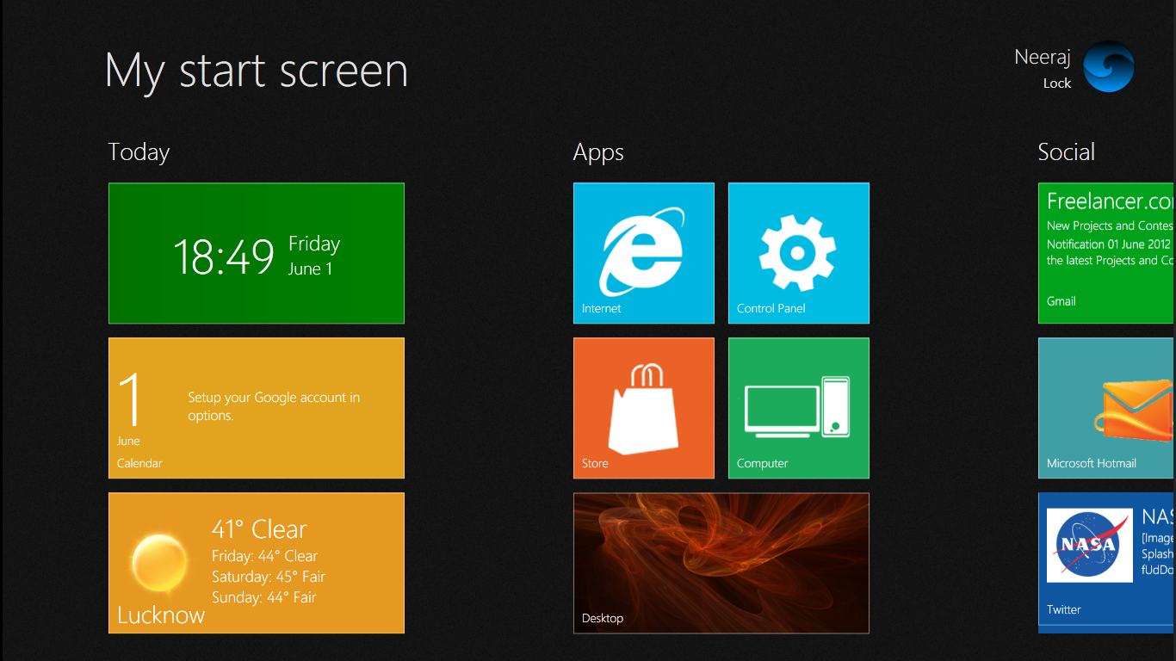
Overview
TilesBar (Hidden)
StartScreen Text
UserTile
Group
Locks current user account
Widget (Tile)
ThumbsBar
(Hidden)
StartBar
(Hidden)

Slide 6

StartScreen
3
4
7
StartScreen [1], main view of Newgen, contains all added tiles in it and allows to interact between them. See image on right.
The right most [2] bar is the StartBar. To open it, Click on the right most of StartScreen.
The text on top [3] is the title of the StartScreen. It allows you to goto left most by clicking.
The UserTile [4] displays your name and picture. It also contains Lock button to lock current account and some R-Click functions.
5
2
6
1
The ThumbsBar [5] allows you to switch to currently opened applications (Windows).
Tiles [6] display some useful content, for which the application is made. If supported, tiles, on-clicking display a hub with more information, also settings or other options on R-Click.
Groups [7], allow to organize your tiles into different categories.

Slide 7
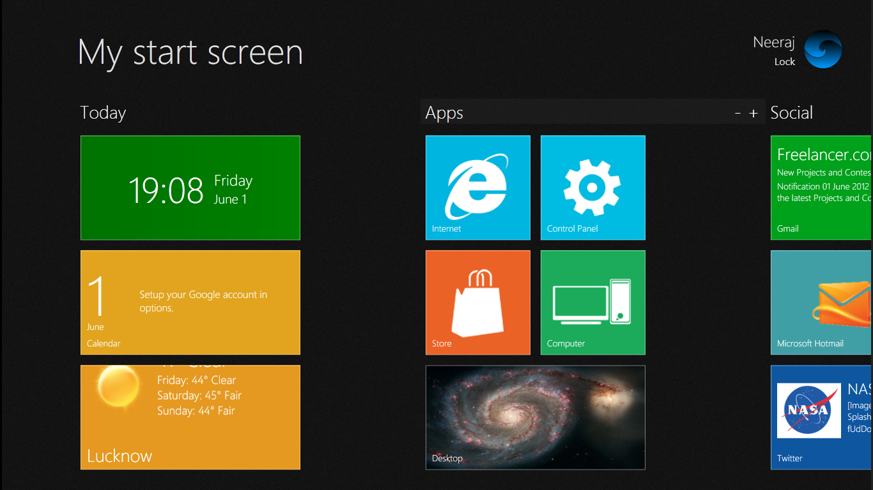
StartScreen Groups
A Group
Create a new group
Deletes the group
Group Name
Group Resizer
Groups allow you to organize your tiles in a categorized manner. There must be a 1 group always, so you cannot delete the last remaining group.
In every group header (as in image above), there are 4 components.
Group Name
Gives a name to a group, to edit click on group name and directly type in it.
Delete Button
Deletes the group, along with all tiles falling in it.
Add Button
Adds / creates a new group next to group on which button is pressed with space of 3 single tiles by column.
Resizer
Allows you to resize the group by pressing mouse-left button and dragging left or right.

Slide 8
Shortcuts
Global Keys (To get help on activate / deactivate, see settings part.)
Left Logo Key = Opens / Hides StartScreen
Right Logo Key = Opens / Hides StartBar
Local Keys
Esc = Closes the opened HubWindow

Slide 9
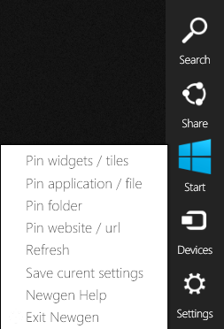
StartBar
1
StartBar is a replacement for traditional Start-Menu. It contains only few necessary buttons. It’s located on right most of StartScreen.
[1] Open your web browser with Google Search.
[2] A Facebook Hub, allows to pin your friends.
[3] Clicking once brings StartScreen into view. Clicking twice takes you to your desktop.
[4] Open Devices Panel of Windows.
[5] Newgen Settings Hub.
[6] Opens TilesBar or TilesToolBar
[7] Allows you to pin (add shortcut) any file to StartScreen.
[8] Allows you to pin any folder.
[9] Allows you to pin (add shortcut) of website.
[10] Refreshes memory resources of Newgen.
[11] Saves your settings.
[12] Opens Newgen’s Integrated Help.
[13] Saves your settings and closes Newgen.
2
6
3
7
8
9
4
10
11
12
5
13

Slide 10
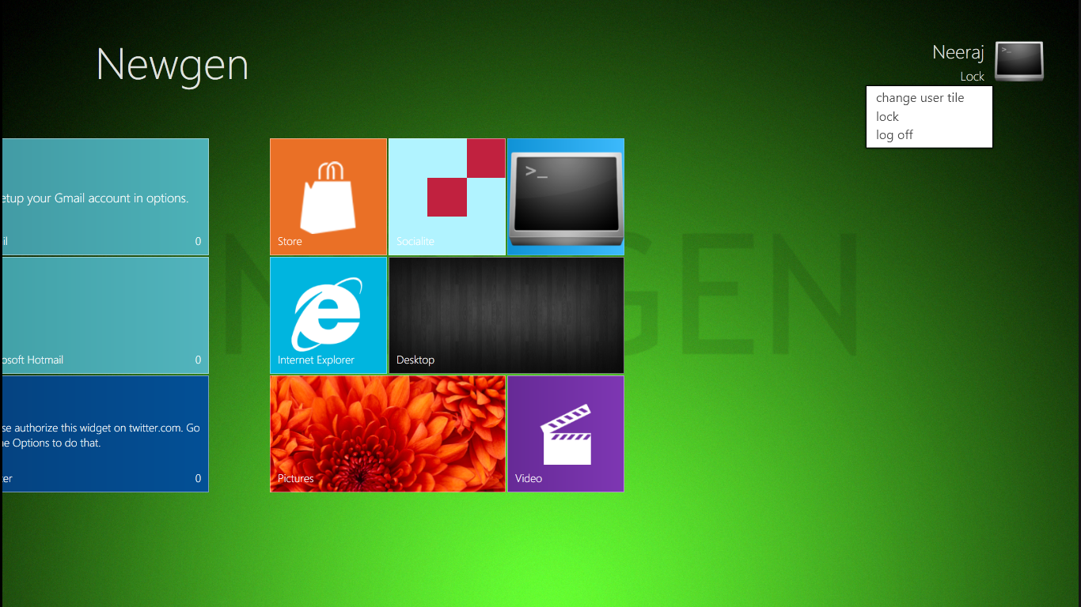
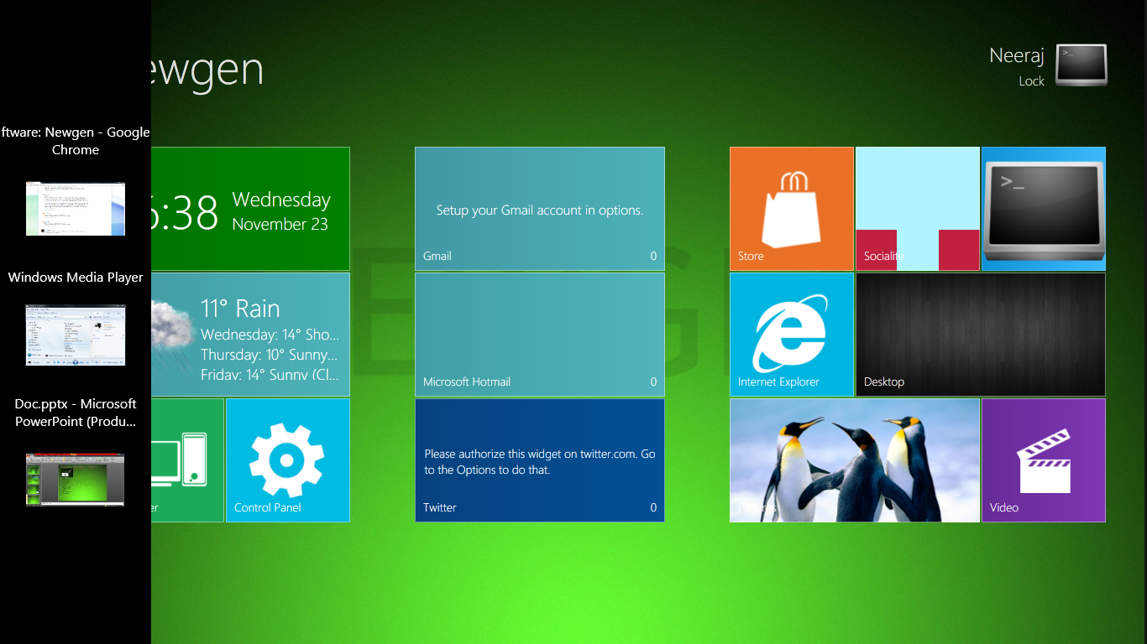
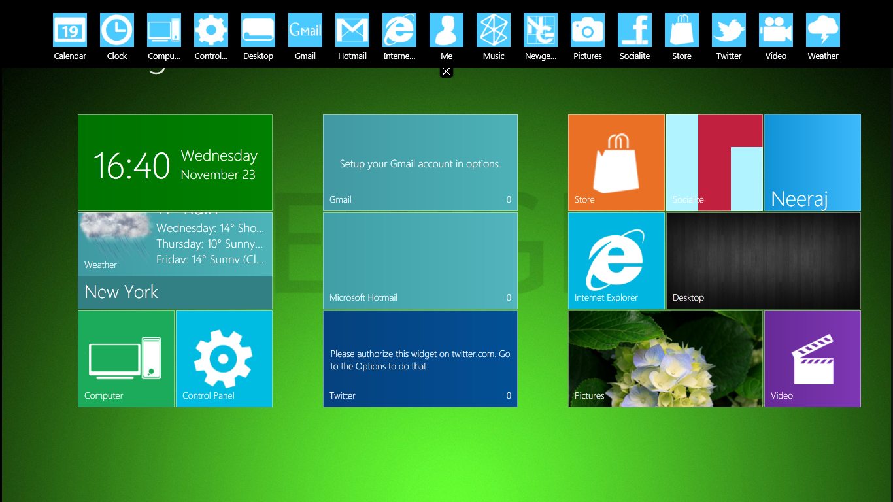
UserTile, ThumbsBar, TilesBar
1
7
2
3
6
4
5
8
[1] Displays your current picture.
[2] [4] Locks current user account.
[3] Allows you to change your [1] picture.
[5] Logoffs current user account.
[6] Live preview of currently opened application. To switch, click this image.
[7] Tile (Widget). Clicking it, toggles the display of widget (Tiles) in StartScreen.
[8] Closes TilesToolbar or TilesBar.

Slide 11
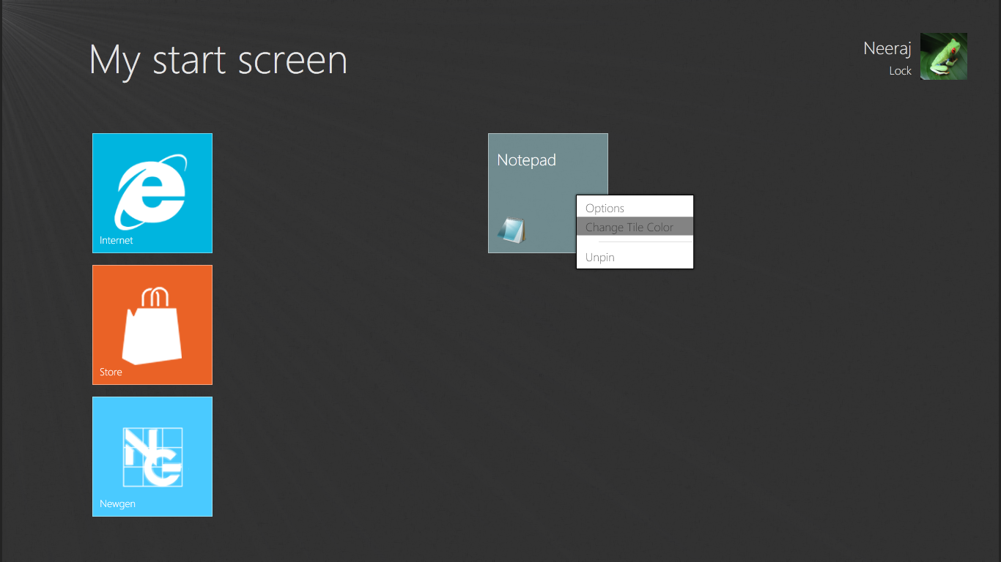
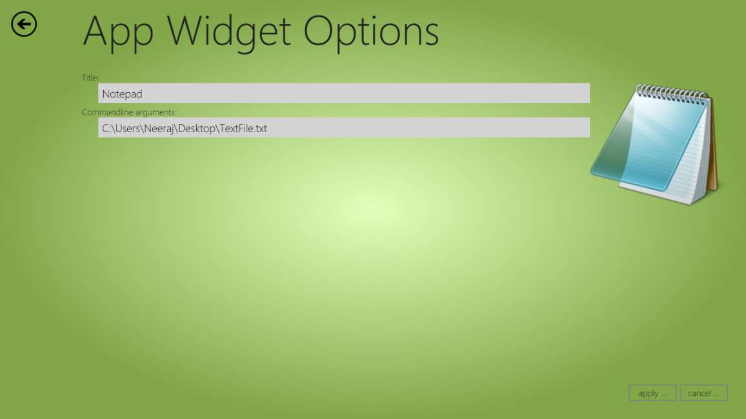
Tiles and App Widget
6
1
7
8
3
4
2
5
[1] Title of App or Shortcut
[2] Icon or Preview of App or File
[3] Opens Options Hub, where you can edit App Widget’s properties
[4] Changes the Background color of Tile.
[5] Removes the Tile from StartScreen.
This is Options hub which comes on clicking [3].
[6] Gives you a preview of App’s Icon or Thumb.
[7] Title of this App Tile
[8] Commandline arguments for this App Tile

Slide 12
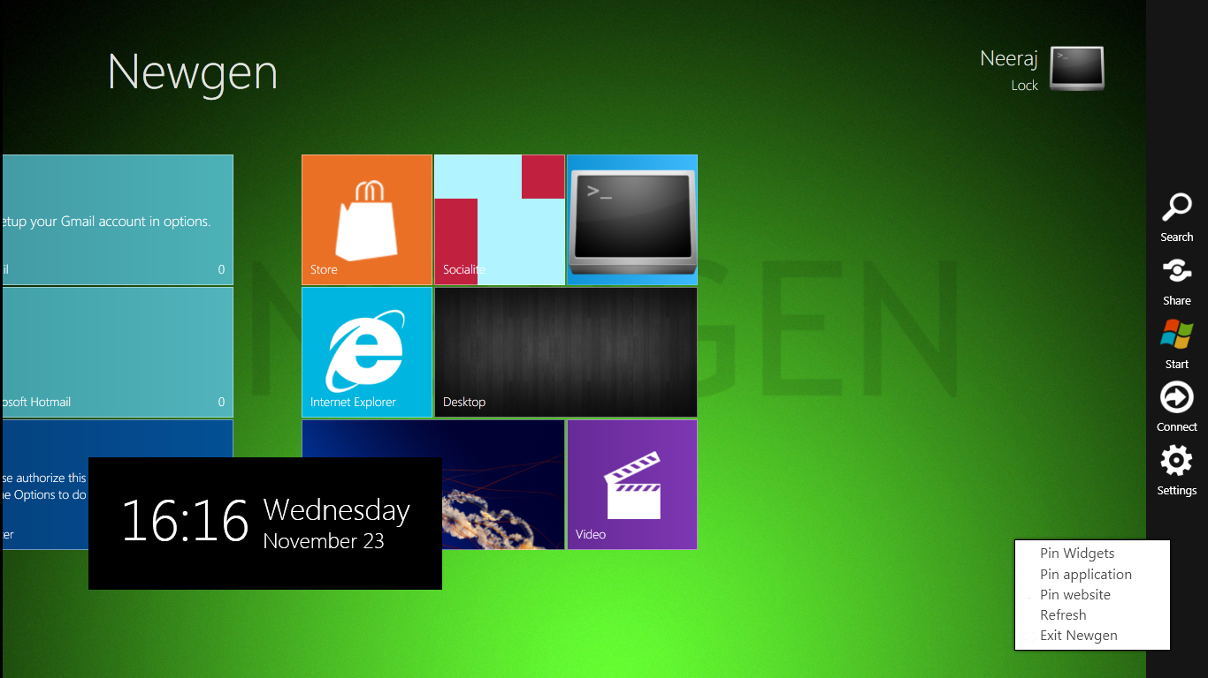
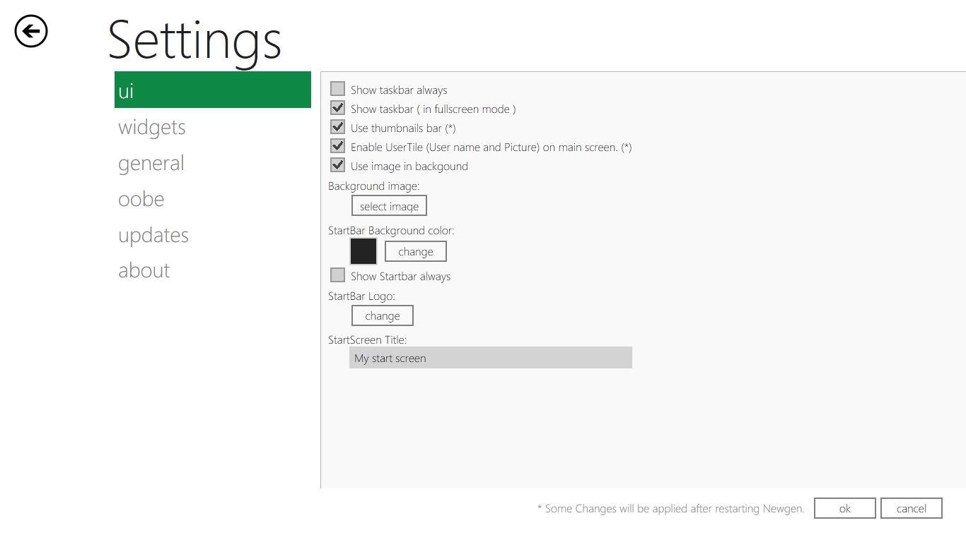
Settings, customizing Newgen Part 1 - UI
Disables hiding your TaskBar permanently
Shows TaskBar, but not in fullscreen mode, but still you can see it if using translucent background
Toggles between ThumbsBar or New experimental App Switcher
Toggles the display of UserTile in StartScreen.
Toogles between Static color or Image for StartScreen background
Changes StartBar background color
Changes StartBar’s Start button’s logo (image)
Changes the text written on top of StartScreen

Slide 13
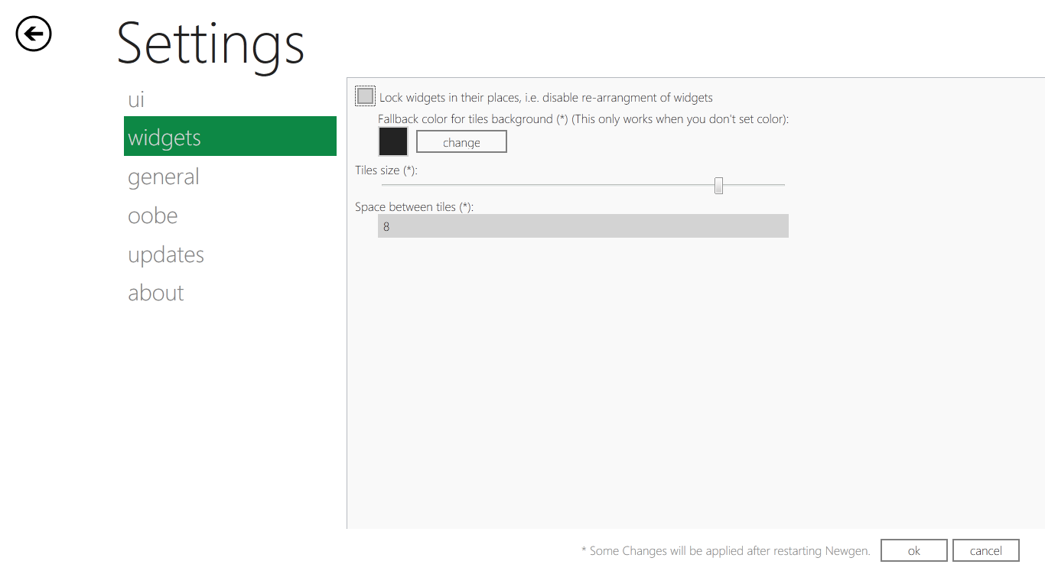
Settings, customizing Newgen Part 2 - Widgets
Locks Tiles in their places, i.e. stops dragging of Tiles
This is fallback value of tiles background
Size of tiles. [It depends on your screen]
Margin between Tiles

Slide 14
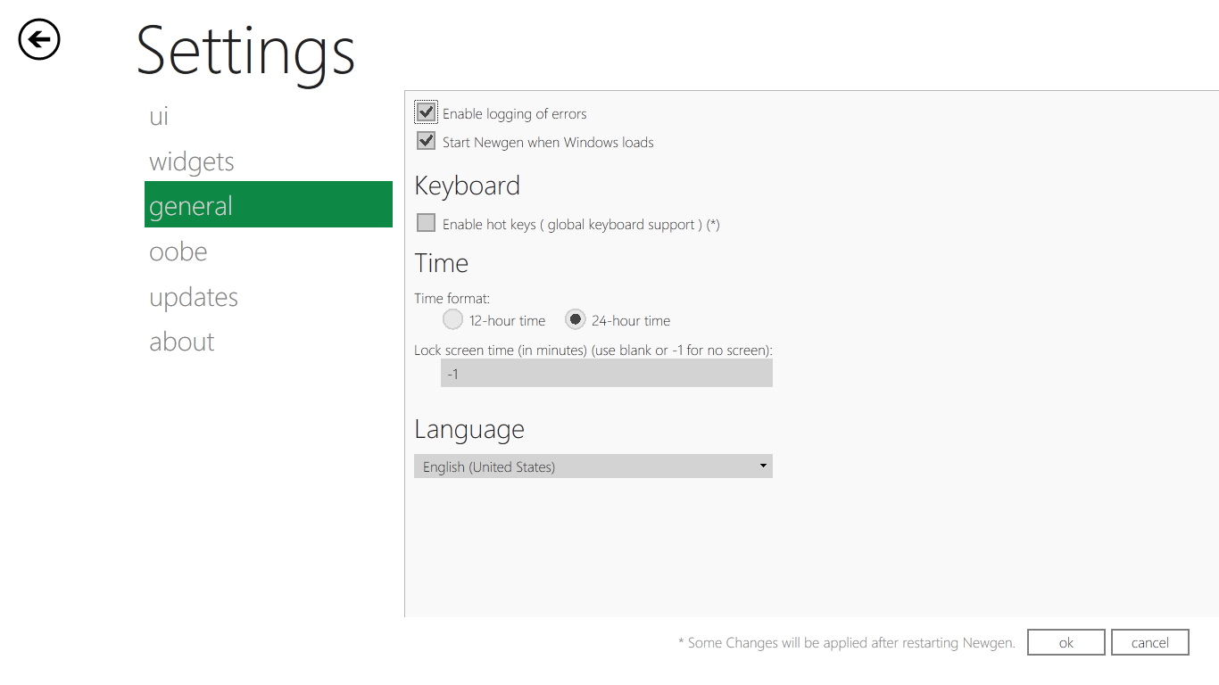
Settings, customizing Newgen Part 3 - General
Enables logging of errors
Starts Newgen with Windows
Enables Hotkeys (Shortcut Keys)
Time display format
Time after which LockScreen will show up, when idle
Language [Currently no other language support, other than English]
If you can help, contact team

Slide 15
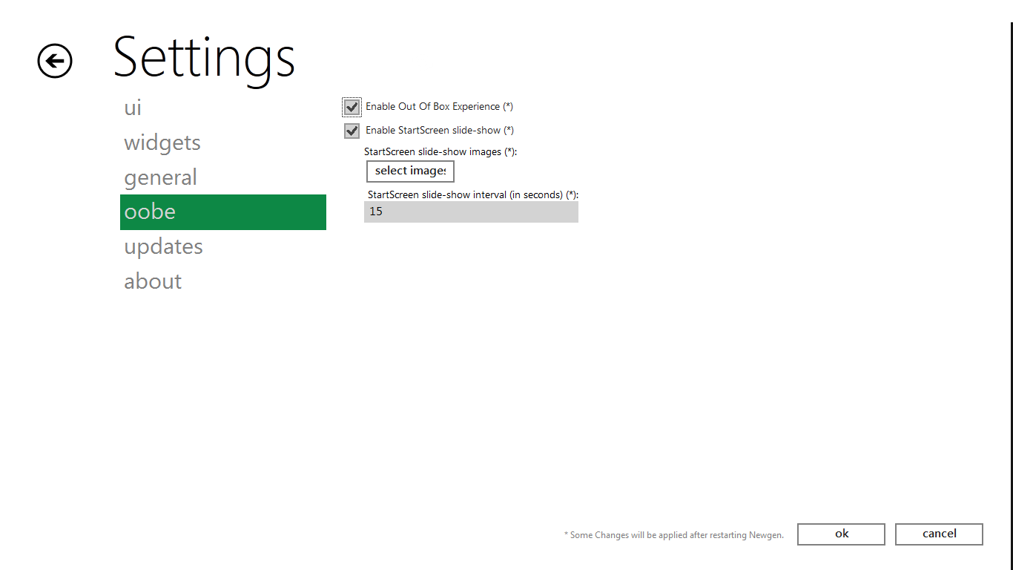
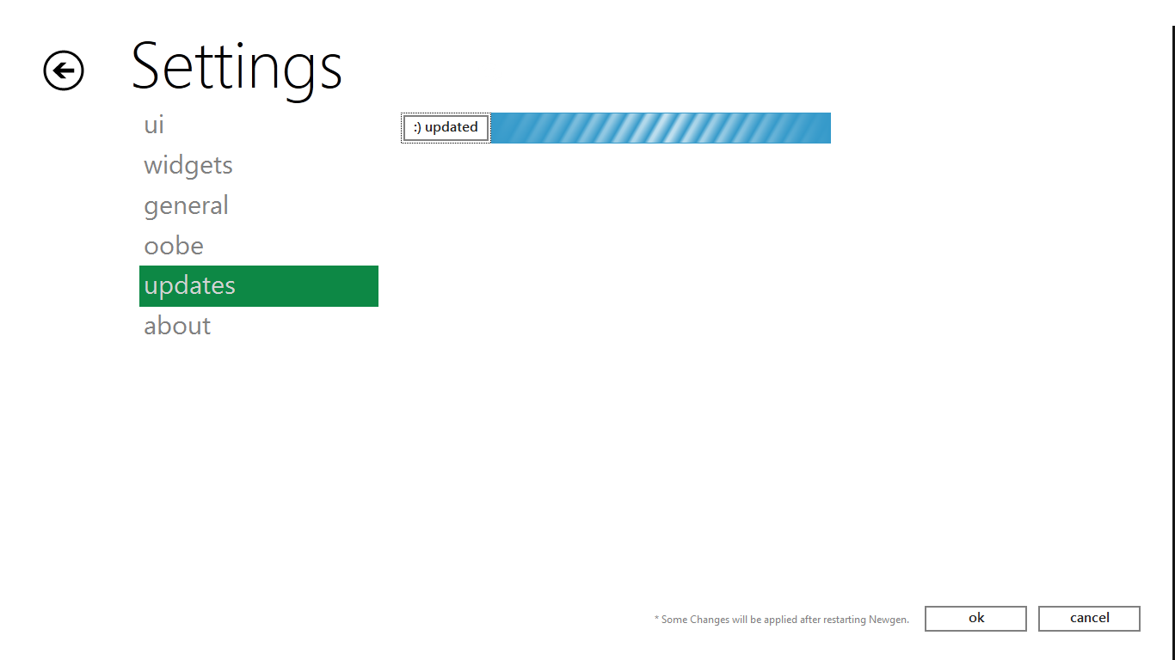
Settings, customizing Newgen Part 4 – OOBE, Updates
Enables experimental features of Newgen
If you like them, tell team to make them stable
Enables Slide-Show in place of static background on StartScreen
Check for latest updates. If available, it will show more details about update.

Slide 16
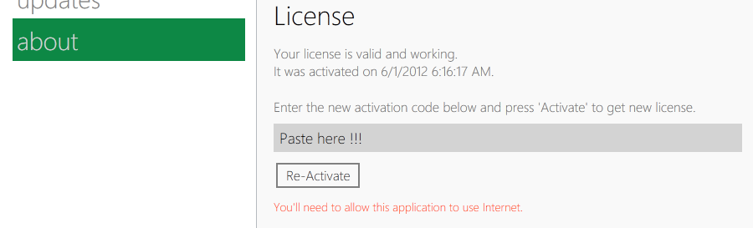
Activating Newgen
To activate Newgen, you must a full version license first.
Goto Settings
Goto About
Paste the activation code in license box
Press activate / re-activate
Restart the Newgen (Manually)

Slide 17
How To’s & What if’s
# How to change position of Tile(s) ?
To change position of Tiles, make sure that ‘Lock Tiles’ is unchecked in Settings->Widgets. Then simply press left-mouse button and start dragging a Tile. A grid will show up on StartScreen, it’s used to determine Tile’s relative position. Now, release mouse button on desired cell of grid to set new position of Tile.
# How to get view of desktop with Newgen at once ?
To get view of desktop, you should decrease the ‘Background Color Transparency’ on Settings->UI. Also check ‘Show Taskbar’ to get view of Taskbar.

Slide 18
How To’s & What if’s
# How to install a widget ?
There are 4 options to do this. But you’re recommended to use Case 1 and 2 as they also install Widget’s metadata information in to Newgen.
If you installed Newgen using installer, then simply get .nwp version of widget from site and double-click it.
If you got Newgen from open files, then you can use Store to install widgets. This also applies to case above.
Cases below are not recommended to be used.
You can also pass arguments to Newgen as like - ‘<Path to Newgen.exe> -nwp “<Path to .nwp file>”’
You can simply copy widget files (open files) to Newgen’s Widgets folder. For ex: If a widget named ‘W’ will be copied to ‘<Path to Newgen folder>\Widgets\W\’

Slide 19
How To’s & What if’s
# What if I upgraded Newgen and Widgets stop working ?
This is generally due to change in Widget API. If can be fixed by deleting the old widgets manually from folder ‘\Widgets’ and re-installing latest widgets.
# I want to buy full license, how ?
To buy full license, go to this www.nsapps.net/Apps/Newgen/. You’ll need to enter your correct email id. After you finish transaction, you’ll receive two email, one containing Newgen Full version license, other containing Transaction receipt from <NS Web Services> admin@nsapps.net. Please add this email to your contact list.

Slide 20
How To’s & What if’s
# I’ve made a widget for Newgen and want it in Newgen Store, how can I ?
# Where is API / Documentation ?
# How can I make widgets ?
Please contact us or visit our site for resources.

Slide 21
How To’s & What if’s
# Why certain things are not working in Newgen ?
You need full version license to make all things work in Newgen.
This includes –
Newgen not saving settings.
No Share/Devices/Search in StartBar.
No UI, Widgets, OOBE settings options.
No button to save settings.
No new widgets installation from Store.
And many more …

Slide 22

Know more
If have more queries or a new feature to be added or found a bug or you want to develop widgets, please feel free to contact us personally in our site or through email.
www.nsapps.net/Apps/Newgen/

